Slide 1
JOB MARKET ANALYSIS
Insights related to job data

Slide 2
STATES WITH MOST NUMBER OF JOBS
SQL Query : SELECT Job_Location, COUNT(*) AS No_of_Jobs FROM Market GROUP BY Job_Location ORDER BY No_of_Jobs DESC LIMIT 5;
Job_Location | No_of_Jobs
CA | 152
MA | 103
NY | 72
VA | 41
IL | 40
SQL Output

Slide 3
AVERAGE MINIMAL AND MAXIMAL SALARIES IN DIFFERENT STATES
SQL Query : SELECT Job_Location, AVG(Lower_Salary) AS minimal_salary, AVG(Upper_Salary) AS maximal_salary FROM Market GROUP BY Job_Location;
Job_Location | minimal_salary | maximal_salary
AL | 40.8750 | 75.0000
AZ | 65.7778 | 105.5556
CA | 92.4276 | 154.5987
CO | 64.2727 | 108.0909
CT | 57.6000 | 84.6000
DE | 43.0000 | 70.0000
FL | 60.3750 | 94.8750
GA | 55.6667 | 105.6667
IA | 56.4000 | 101.4000
SQL Output

Slide 4
AVERAGE SALARY IN DIFFERENT STATES
SQL Query : SELECT Job_Location , AVG(Avg_SalaryK) AS average_salary FROM Market GROUP BY Job_Location;
Job_Location | average_salary
CA | 123.51316
IL | 116.66250
DC | 110.18182
MA | 107.49515
NJ | 104.55882
SQL Output

Slide 5
TOP 5 INDUSTRIES WITH MAXIMUM NUMBER OF DATA SCIENCE RELATED JOB POSTINGS.
SQL Query : SELECT Industry, COUNT(*) AS job_count FROM Market WHERE job_title_sim LIKE 'd%t' GROUP BY Industry ORDER BY job_count DESC LIMIT 5;
Industry | Job_count
Biotech & Pharmaceuticals | 38
Insurance Carriers | 28
Computer Hardware & Software | 27
Enterprise Software & Network Solutions | 25
IT Services | 22
SQL Output

Slide 6
COMPANIES WITH MAXIMUM NUMBER OF JOB OPENINGS
SQL Query : SELECT Company_Name, COUNT(*) AS Job_Openings FROM MarketGROUP BY Company_Name ORDER BY Job_Openings DESC LIMIT 5;
Company_Name | Job_Openings
MassMutual | 14
Reynolds American | 14
Takeda Pharmaceuticals | 14
Software Engineering Institute | 11
PNNL | 10
SQL Output

Slide 7
Job Titles with Most Number of Jobs.
SQL Query : SELECT Job_Title, COUNT(*) AS Num_of_Jobs FROM Market GROUP BY Job_Title ORDER BY Num_of_Jobs DESC LIMIT 5;
Job_Title | AS Num_of_Jobs
Data Scientist | 131
Data Engineer | 53
Senior Data Scientist | 34
Data Analyst | 15
Senior Data Engineer | 14
SQL Output

Slide 8
SALARY OF JOB TITLES WITH MOST NUMBER OF JOBS
SQL Query : SELECT Job_Title, COUNT(*) AS Num_of_Jobs, AVG(Avg_SalaryK) AS average_salary FROM Market GROUP BY Job_Title ORDER BY Num_of_Jobs DESC LIMIT 5;
Job_Title | Num_of_Jobs | average_salary
Data Scientist | 131 | 106.17939
Data Engineer | 53 | 91.66038
Senior Data Scientist | 34 | 134.86765
Data Analyst | 15 | 66.30000
Senior Data Engineer | 14 | 121.92857
SQL Output

Slide 9
RELATION BETWEEN AVERAGE SALARY AND EDUCATION
SQL Query : SELECT Degree, AVG(Avg_SalaryK) AS average_salary FROM Market GROUP BY Degree;
DEGREE | Average_salary
P | 115.98131
M | 105.63492
na | 94.70366
SQL Output

Slide 10
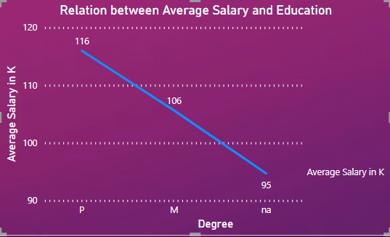
INSIGHTS RELATED TO DATA PROVIDED
1) Education and Salary: The data suggests that higher education is associated with higher salaries. On average, individuals with a Ph.D. earn $116,000, those with a Master's degree earn $106,000, and those with a Bachelor's degree or without a specified degree earn $95,000.

Slide 11
2) Job Titles: The most common job titles in the dataset are Data Scientist (131 jobs), Data Engineer (53 jobs), Senior Data Scientist (34 jobs), Data Analyst (15 jobs), and Senior Data Engineer (14 jobs). Data Scientist positions have the highest number of job openings and tend to offer higher average salaries compared to other job titles. However, Senior Data Engineers have fewer job openings but offer relatively high salaries.

Slide 12
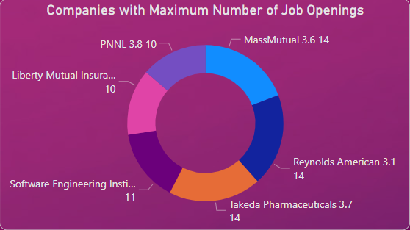
3) Top Companies: The companies with the highest number of job openings include Mass Mutual, Reynolds American, Takeda Pharmaceuticals, Software Engineering Institute, Liberty Mutual Insurance, and PNNL. These companies have 14, 14, 14, 11, 10, and 10 job openings, respectively. It is worth noting that Software Engineering Institute focuses its job openings in Pennsylvania, Mass Mutual in Massachusetts, and PNNL in Washington (WA).

Slide 13
4) Industries: The top industries with the most data science-related job postings are Biotech and Pharmaceuticals (38 jobs), Insurance carriers (28 jobs), Computer Hardware and
Software (27 jobs), Enterprise Software and Network Solutions (25 jobs), and IT Services (22 jobs).
5) States with Highest Salaries: The states offering the highest average salaries for data science positions are California (CA) with an average of $123,000, Illinois (IL) with $117,000, Washington D.C. (DC) with $110,000, Massachusetts (MA) with $107,000, and New Jersey (NJ) with $104,000.

Slide 14
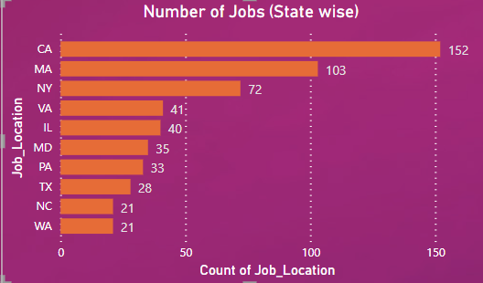
6) States with Most Job Openings: California (CA) has the highest number of job openings (152 jobs), followed by Massachusetts (MA) with 103 jobs, New York (NY) with 72 jobs, Virginia (VA) with 41 jobs, and Illinois (IL) with 40 jobs. California not only has the most job opportunities but also offers the highest average salary among the states.

Slide 15
7) Top 5 Skills Required by Companies for Most Job Openings : PYTHON (392) , EXCEL (388) , SQL (380) , AWS (176) , SPARK (167) times has been asked by companies.
8) Degree and Job Openings: Individuals with a Master's degree (M) have the maximum number of job openings compared to other educational candidates. Additionally, all types of educational candidates have job opportunities in industries like Biotech and Pharmaceuticals and Enterprise Software and Network Solutions. California (CA), Massachusetts (MA), and New York (NY) have job openings available for all types of educational candidates.
9) These insights provide an overview of the relationship between education, job titles, companies, industries, states, and salaries in the given data. They can be useful for understanding trends in the data science job market.

